Slide 1
Applied Computer Graphics and Vision
Lecture 06: Coordinates and Transformations

Slide 2
Overview
Intro: transformations in the graphics pipeline
Matrix basics
Points, vectors and homogeneous coorindates
Translation, rotation and scale
General transformation

Slide 3

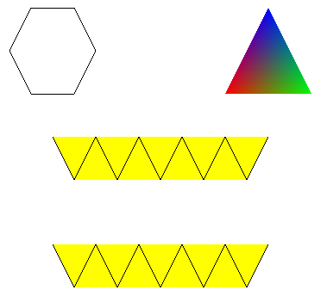
Draw in 2D
So far, when we draw a shape, we specify the vertex coordinates in a normalised coordinate system.
y
(-1, 1)
(1, 1)
(-1, 1)
(1, 1)
x
x
(-1, -1)
(1, -1)
(-1, -1)
(1, -1)

Slide 4
Cont’
The coordinate system we have used:
  The range of x and y axes is from -1.0 to 1.0.
  The Z axis is not used.
This coordinate system is the clipped or 3D screen system (ref. graphics pipeline).
By doing this we have omitted the transformations that should be applied to the vertex coordinates in the vertex shader before they are passed on to the next stage of the graphics pipeline.

Slide 5
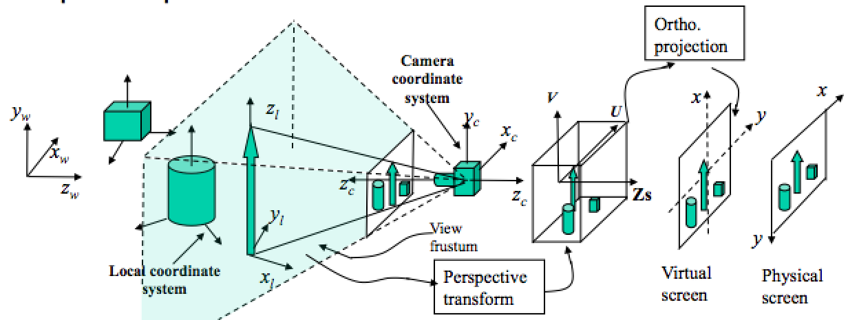
Graphics Pipeline & Transformations
We have defined the shapes in this coordinate system
gl_Position receives data at this point
The clipped coordinates are what the built-in variable gl_Position expects after the vertex shader has finished with its job.

Slide 6
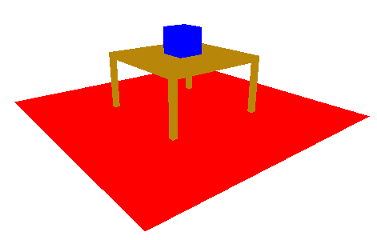
Draw in 3D
As we go to 3D, is extremely hard to define shapes in the clipped coordinate system, because we need to take the perspective effect into consideration.
We have to use transformations to control the position, orientation and/or scale of objects and the way by which the objects are drawn (view point & camera parameters).

Slide 7
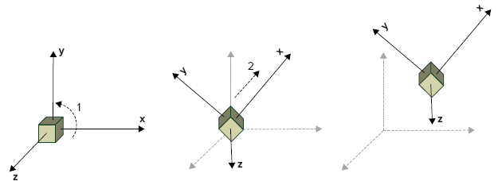
Transformations
In a 3D scene objects can be transformed by the following transformations:
  translation: change its position
  rotation: change its orientation
  scale: Change its dimension – make it bigger or smaller, squeezed in one dimension and stretched in another, etc
These transformations are realised by multiplying coordinates of the vertices (points) of the objects to transformation matrices.

Slide 8
Review: Matrices
Row matrix (1row X n column)
Column matrix (nx1)
Row & column matrix are also called vectors
Square matrix (nxn)
General matrix (mxn)

Slide 9
Review: Matrix Multiplication
Two general matrices:
Their product is a m-by-p matrix
whose elements are computed:

Slide 10
Matrix Multiplication
E.g.,

Slide 11
Cont’d
Another example:

Slide 12
Point Coordinates
In analytical geometry, a point P(x,y,z) is represented by its coordinate values, x, y and z.
It is written in matrix form (a column matrix):
  or written as the transpose of the column matrix
z
z
P(x, y, z)
y
y
x
x

Slide 13
Translate a Point
In a coordinate system, translating a point means to move it to a new position (This usually means we need to find its coordinates at the new position).
This change of position can be viewed in two different but equivalent ways:
  the coordinate system is fixed and the point is moved
  the point is fixed, but the coordinate system is moved in opposite direction.
z
P(x₂, y₂, z₂)
z
P(x₂, y₂, z₂)
z
P(x₂, y₂, z₂)
P(x₁, y₁, z₁)
y
y
x
y
x
x
move the point
move the coordinate system

Slide 14
Translation Vector
A translation (the amount and direction of displacement) can be represented as a vector – a geometric entity that has a direction and a length.
The vector is written in terms of its projections on the coordinate axes (the lengths of blue line segments)
Z
p₂
v
p₁
Y
O
X

Slide 15
Points v.s. Vectors
By looking at the matrix form of points and translation vector, we cannot really tell which is which. They are all written as column matrices.
A way out of this (and with other more important benefit) is to use homogeneous coordinates

Slide 16
Points in Homogeneous Coord.
In homogeneous coordinate, a point has a fourth dimension, i.e., its coordinates have the form
(x_{h}, y_{h}, z_{h}, w)
where w is a nonzero value.
The value of w is decided by the following relationship:
where (x,y,z) is the conventional coordinates of the point.

Slide 17
Cont’d
For example, a point (2, 3.5, 4) in conventional coordinates can be written in homogeneous coordinates as (4, 7, 8, 2) or (-1, -1.75, -2, -0.5). They are equivalent to (2, 3.5, 4).
Obviously, a point can have infinite homogeneous coordinates (as long as you can get the original coordinates by dividing the first three coordinates by the 4th coordinate).
For convenience and uniqueness, the 4th value is set to w=1, i.e., (2, 3.5, 4, 1).

Slide 18
Vectors in Homogeneous Coord.
Similar to points, a vector in homogeneous coordinate has a fourth component, but it is always set to be "0”
That means you can tell a point from a translation vector by looking at the 4th coordinate.

Slide 19
Relationship Between Points and Vectors
Two points in space define a direction and a length – these are the properties of a vector.
It is obvious, subtracting a point from another point gets a vector and adding a vector to a point gets a new point
Z
p₂
v
p₁
Y
O
X

Slide 20
Translate a Point
From our discussion, it is clear that translation of a point is matter of adding a vector to the point.
If a point moves from p to p₁ by a vector t:
P₁(x₁, y₁, z₁)
t
P(x,y,z)

Slide 21
Translation Transformation
Written in matrix form, we have:
Notice that, if we don’t use homogeneous coordinates of points, we cannot write a translation operation as matrix multiplication.
Translating an object is a matter of multiplying the transformation with the coordinates of all its vertices.
let
then we call T the translation transformation

Slide 22
Rotate Around an Axis
Similar to translating a point, rotating a point around a coordinate axis can also be done in two different but equivalent ways:
  the coordinate system is fixed and the point is rotated around the the axis perpendicular to the plane of rotation (z axis in this example), or
  the point is fixed, but the coordinate system is rotated around the axis.
Position before rotation
y
y
y
p(x₁, y₁)
Position after rotation
p(x₂, y₂)
p(x₂, y₂)
p(x₂, y₂)
θ
θ
x
θ
x
x
Rotate the point
Rotate the coordinate system

Slide 23
Rotate Around an Axis
Given a point p(x₁, y₁, z₁) and a coordinate system, the new coordinates of the point, (x₂, y₂, z₂), after rotating the point around an coordinate axis, e.g., z axis, by an angle θ, can be easily computed:
y₁
y₂
x₂
Writing thre above equations in matrix form, we have:
x₁
We call Rz(θ) the rotation transformation around z axis
Let

Slide 24
Cont’d
Similarly, we can obtain the rotation transformations around x and y axes:
These 3x3 matrices are called elementary rotation matrices.

Slide 25
Composite Rotation
In real application, to achieve the desired orientation, we may need to rotate an object many times.
Suppose we have a point p(x,y,z), we first rotate it θ₁ about x, then θ₂ about z, then θ₃ about y, then θ₄ about z, etc. We have:
After a rotation of θ₁ about x axis
After a rotation of θ₂ about z axis
After a rotation of θ₃ about y axis
After a rotation of θ₄ about z axis

Slide 26
Composite Rotation
We calculate the coordinates of the point following the order of the rotations, we have
In general,
where m_{ij} are some real values.
The 3x3 matrix, R(θ₁,θ₂,θ₃,… θ_{n},), is called a composite rotation transformation.

Slide 27
Rotation Transformations in Homogeneous Coord.
If points are given in homogeneous coordinates, we write the matrices in homogeneous form by having one more row at the bottom and one more column at the last column:
The composite rotation transformation becomes

Slide 28
Combining Translation with Rotation
Suppose we know an object: its position and orientation is represented by its local coordinate system that is at O₁(x₁, y₁, z₁) in terms of the world coordinate system. We now want to move and rotate so that it located and oriented as coordinate system O₂(x₂, y₂, z₂).
The spatial relationship between the two coordinate systems is defined by a translation t, and a rotation R.
z₂
z₁
y₂
z’
y’
o₂
o₁
y₁
x₂
x₁
x’

Slide 29
Cont’d
We obtain the coordinates O₂ (x₂, y_{2,} z₂) by:
  first rotating the object by R to obtain an intermediate coordinate system O’, which align with O₂,
  then by translating it by t so that it is actually at O₂
Step 1:
Step 2:

Slide 30
Cont’d
The computation on the previous slide is equivalent to the following matrix multiplication:
We now have a new transformation:
T combines rotation with translation and is called a general transformation.
Rotation
Translation

Slide 31
Scale
Scale is a simple operation that changes the dimensions of an object.
The change is done by multiplying a constant to the coordinates of all vertices. E.g.,
  multiplying the x-coordinates of the vertices of an object by 2 doubles its size in x-dimension,
  multiplying the y-coordinates of the vertices of an object by 0.5 halves its size in y-dimension,
Written in matrix form
where s_{x}, s_{y} and s_{z} are scale factors in the x-, y- and z-dimension

Slide 32
Examples
Double size in x-dimension
Double size in x-dimension and shrink size in y-dimension by 0.2

Slide 33
Scale transformation can also be combined with other transformations
Show this by multiplying the general transformation with the general scale transformation.

